Slide 1
A Relativistic 1D Hydro Code
Joseph Corrado

Slide 2
New Conserved Variables
In the relativistic case, the conserved quantities we evolve are the rest mass density, the momentum density, and the energy density - ( D , S , \tau )
The corresponding fluxes are given by - ( Dv , Sv + p , S - Dv )
The relations between the new conserved variables and the primitives are analogous to the non-relativistic case, but they include the lorentz factor:
W^2 = 1 / ( 1 - v^2 ) (c=1)

Slide 3
A Few Minor Adjustments
In addition to changing the physical fluxes and conserved variables, I also needed to implement different eigenvalues and a speed of sound corresponding to the relativistic case
Cs^2 = (gamma-1)/h * ( e + ( P / rho ) )
\lambda = (v \pm cs )/(1\pm v *cs)
Here, I’ve also needed to compute the specific internal energy and the specific enthalpy because the specific enthalpy is used in the computation of the state variables in relativistic hydrodynamics

Slide 4
Retrieving the Primitives from Conserved Variables
In the relativistic case, the primitive variables are coupled to the laboratory conserved quantities via the lorentz factor.
As a result, need to recover the primitives from the conserved variables using a root finding method (i.e. Newton-Raphson ).

Slide 5
Implementation
In my project, I have implemented the forward euler and rk3 update schemes, as well as the piecewise constant and piecewise linear reconstruction techniques using the generalized minmod slope limiter with the FHLL approximate riemann solver.
I have implemented both outflow and periodic boundary conditions.
For recovering the primitives from the conserved variables, I have used the built-in scipy.optimize.newton for the root finding method.

Slide 6
Root Finding Method
When solving the nonlinear implicit equation for the pressure while solving for the primitive variables, it is possible to get nonphysical results as the root.
It is possible that I get negative values for the value of the pressure.
When this happens, I manually assign those values of the pressure to the minimum of the physically allowed pressure: pmin = |S - \tau - D|
Also, I manually correct v whenever I get a value greater than 1

Slide 7
Where I am now
Currently, my relativistic hydrocode does not give me the expected output for any of the primitive variables.
Before, the issue was with the root finding method, where newton’s method wasn’t converging onto a proper value, but then I changed which primitive I computed using the root finding method, and now it seems to not have any issues converging.
However, now it seems to be taking too large of a timestep immediately, which makes me think the issue is with the computation of the eigenvalues for my problem, which would still point to some error in finding the correct root

Slide 8
Goals
Get the 1D special relativistic code working.
After that, compare to multiple test cases
Open to suggestions

Slide 9
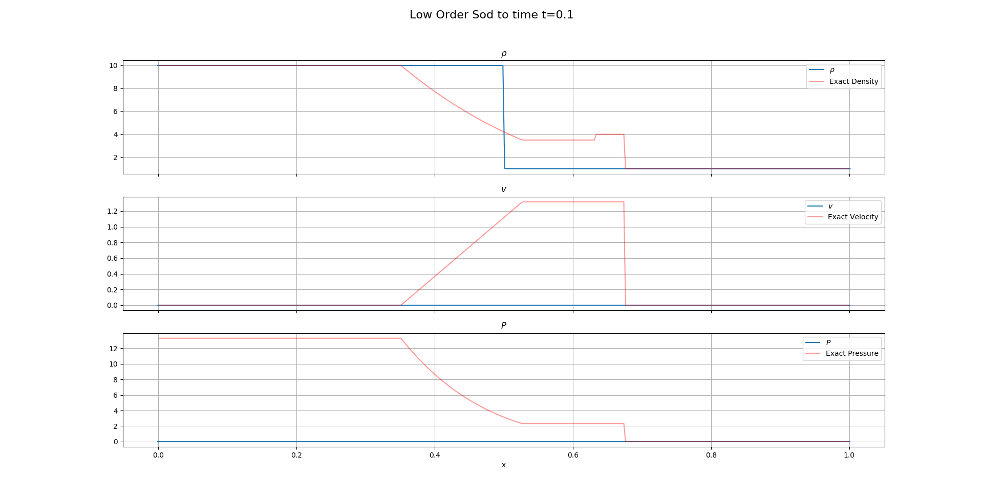
Additional Slides
Current relativistic sod shock problem: left - [10,0,13] , right - [1,0,1e-8]

Slide 10
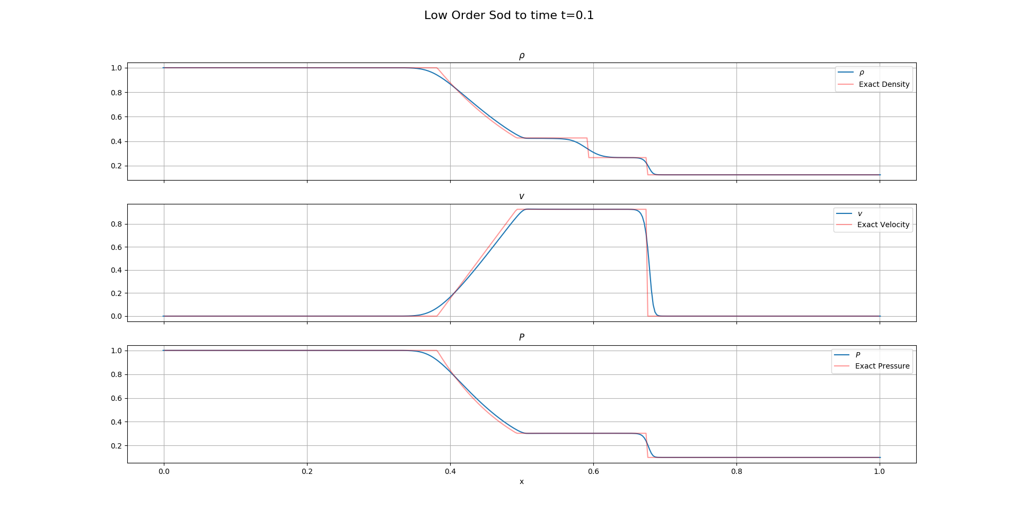
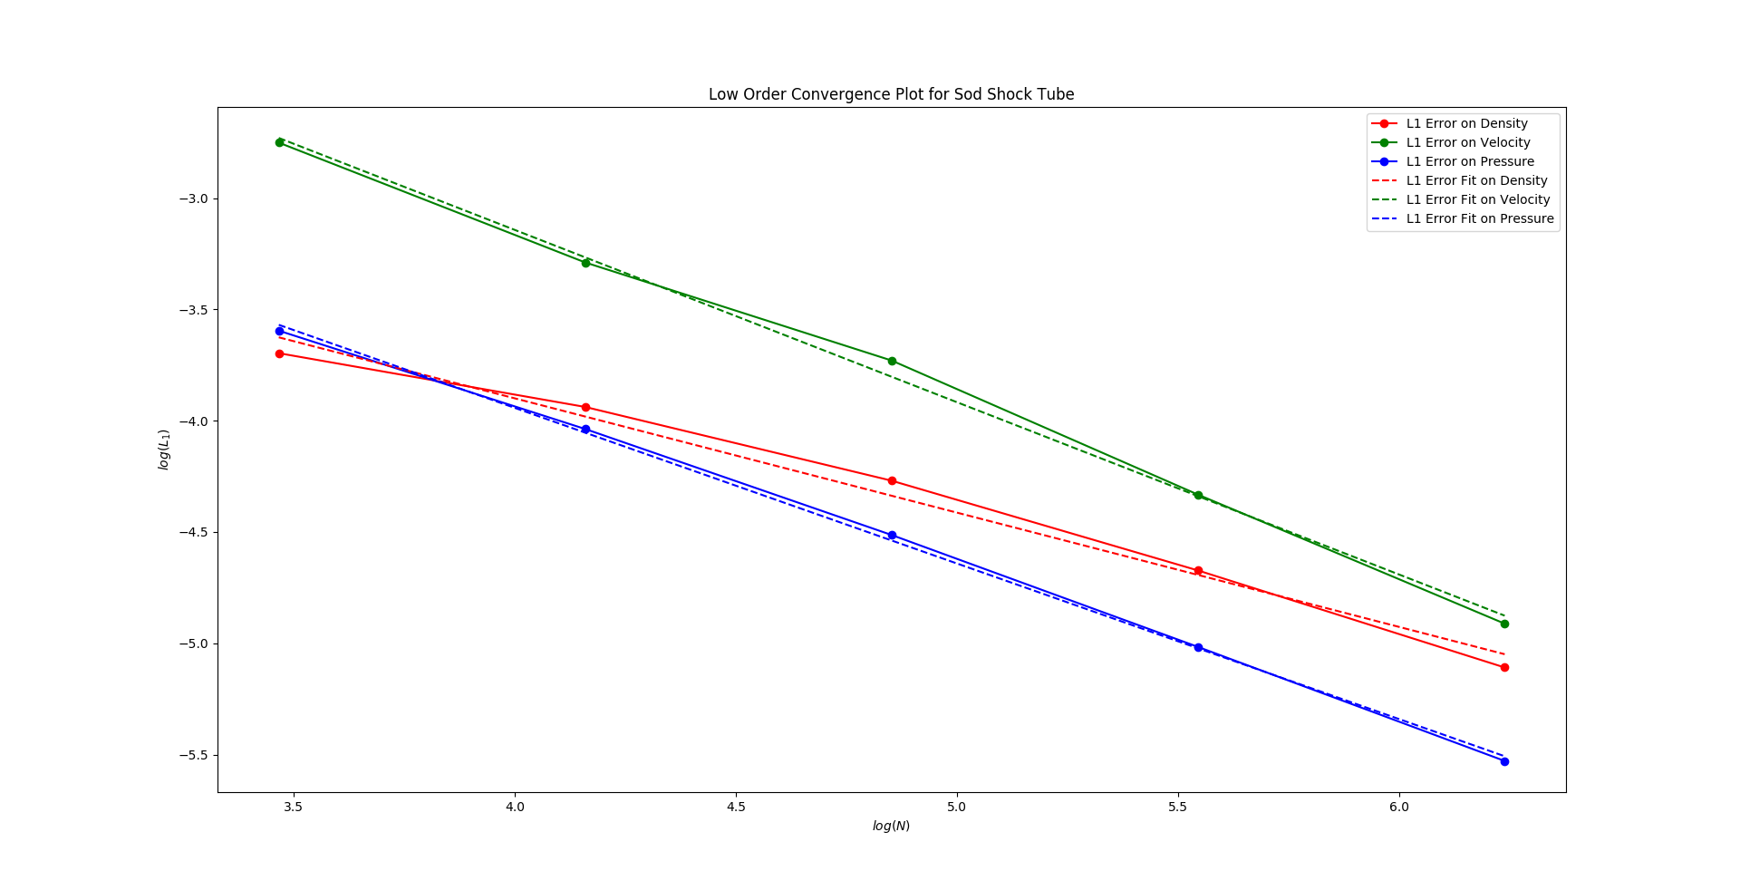
Low Order Nonrelativistic Sod Shock Tube
Left - [1,0,1] ; right - [0.125,0.0,0.1]
Convergence Rates - 0.513 , 0.76 , 0.698

Slide 11
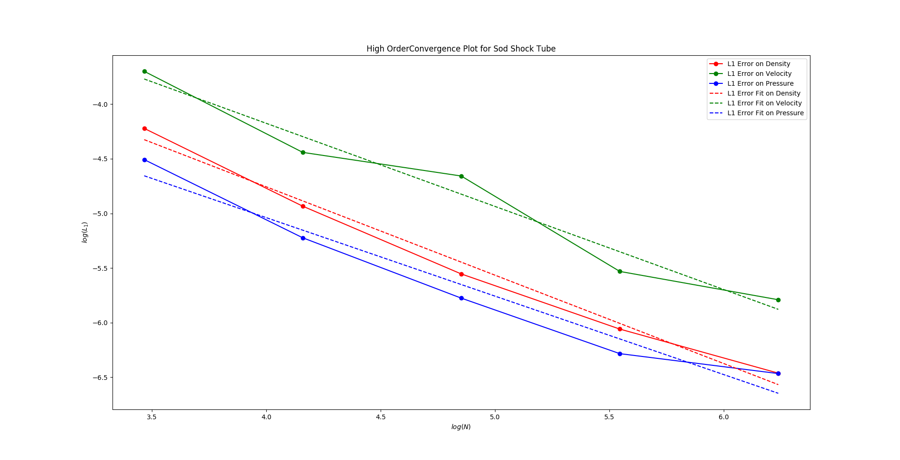
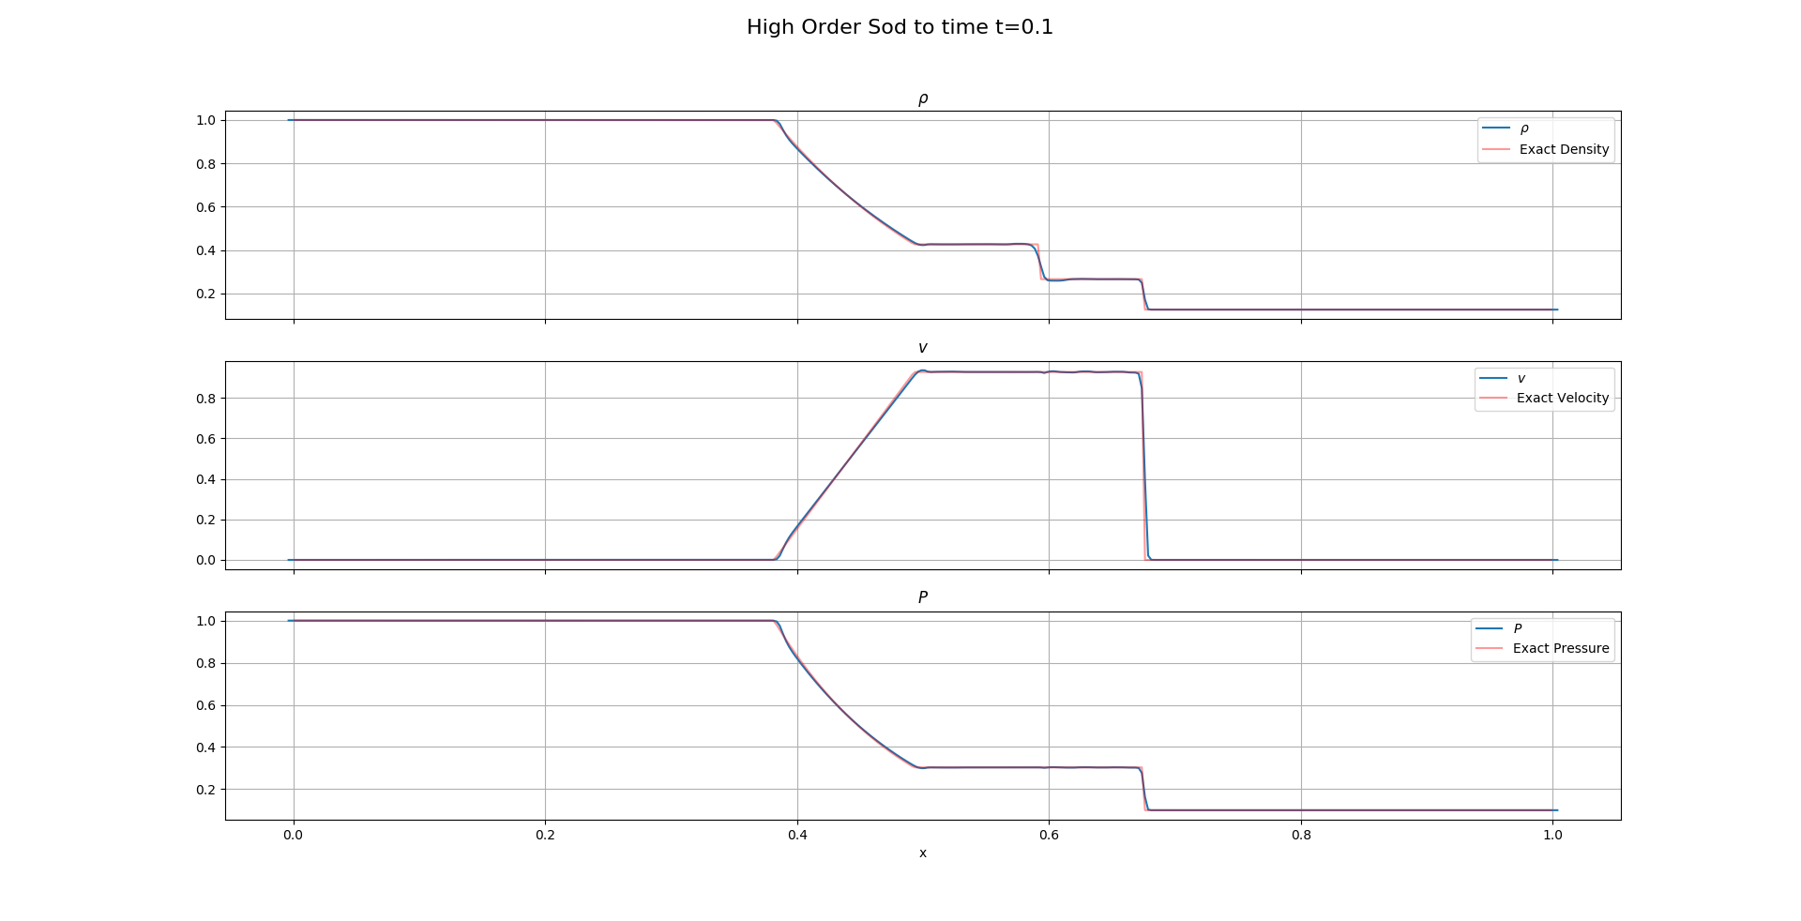
High Order Nonrelativistic Sod Shock Tube
Convergence Rates - 0.8 , 0.76 , 0.71

Slide 12
Maths
Relativistic Eigenvalues = (v \pm cs)/(1\pm v*cs)
Relativistic specific enthalpy h = 1 + e + ( P / rho )
Ideal gas eos: P = ( gamma -1 ) rho * e
Implicit function for root finding: P-(gamma-1) * rhostar * estar = 0
Vstar = S / ( tau + P + D )
Wstar = lorentz( vstar )
Estar = ( tau + D * ( 1 - wstar) + ( 1-wstar^2)*P)/(D * wstar )
Rhostar = D / Wstar

Slide 13
Maths (cont.)
D = lorentz * rho
S = rho * h * lorentz^2 * v
Tau = rho * h * lorentz^2 - P - lorentz * rho
F[0] = v * D
F[1] = v * S + P
F[2] = v * tau + v * P
Cs^2 = (gamma-1)/h * ( e + ( P / rho ) )

Slide 14
Maths (cont)
minmod(x,y,z)=¼*|sign(x)+sign(y)|*(sign(x)+sign(z))*min(|x|,|y|,|z|)
FHLL = (ap*FL+am*FR-ap*am*(UR-UL))/(ap+am)
apm = MAX{0, \pm \lambda\pm( UL) , \pm \lambda\pm ( UR)}
c L i+1/2 = c i + 0.5 minmod(θ (c i − c i−1 ), 0.5 (c i+1 − c i−1 ), θ (c i+1 − c i ))
c Ri+1/2 = c i+1 − 0.5 minmod(θ (c i+1 − c i ), 0.5 (c i+2 − c i ), θ (c i+2 − c i+1 ))
LU = -1/dx*(Fi+½-Fi-½)

Slide 15
References
Solving 1-D Special Relativistic Hydrodynamics(SRH) Equations
Using Different Numerical Method and Results from Different Test Problems
Orhan Dönmez
(2) RAM: A RELATIVISTIC ADAPTIVE MESH REFINEMENT HYDRODYNAMICS CODE - ZHANG & MACFADYEN
(3) Relativistic Hydrodynamics - Rezzolla and Zanotti

